Slide 1
Boosting
UIUC ECON 490: Applied Machine Learning in Economics

Slide 2
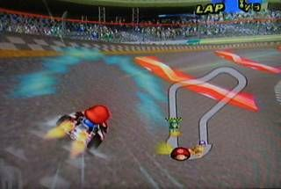
Boosting – Getting help fixing mistakes
Ensemble learning
Bagging
Boosting
Stacking

Slide 3
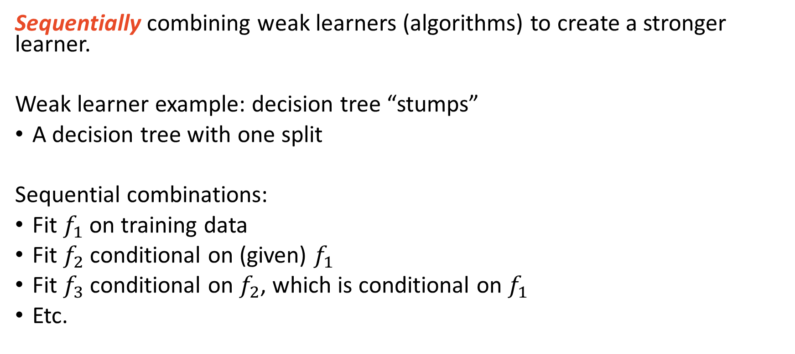
Boosting – Sequential Ensemble Learning
Sequentially combining weak learners (algorithms) to create a stronger learner.
Weak learner example: decision tree “stumps”
A decision tree with one split
Sequential combinations:
Fit $f_{1}$ on training data
Fit $f_{2}$ conditional on (given) $f_{1}$
Fit $f_{3}$ conditional on $f_{2}$, which is conditional on $f_{1}$
Etc.

Slide 4
Two primary types of boosting
AdaBoost - Adaptive Boosting
Fit models one after another (sequentially)
Pay more attention to observations that prior model fit poorly
Gradient Boosting
Fit model, obtain residuals
Fit next model on prior residuals
Etc.

Slide 5
AdaBoost
Help with what your friends missed

Slide 6
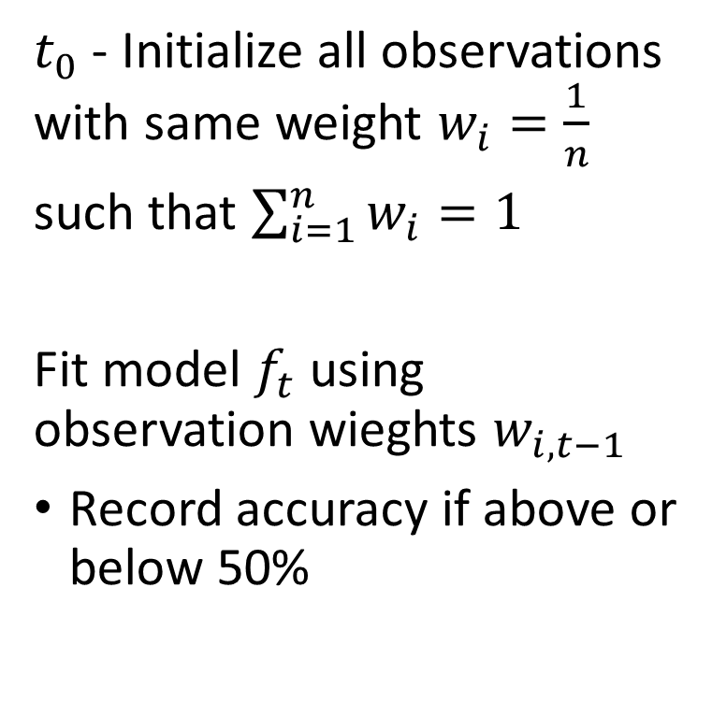
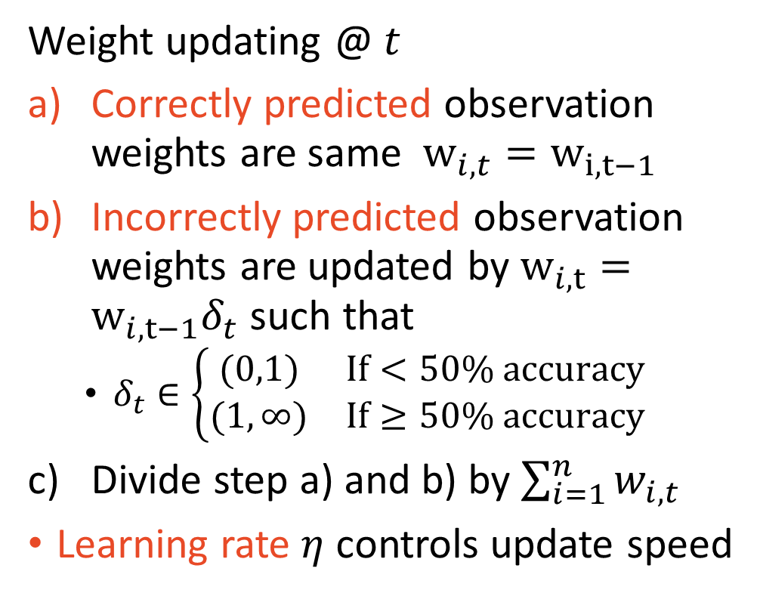
AdaBoost Pseudo Code (here $t$, textbook $j$)
$t_{0}$ - Initialize all observations with same weight $w_{i}=\frac{1}{n}$
such that $\sum_{i=1}^{n}{w_{i}=1}$
Fit model $f_{t}$ using observation wieghts $w_{i,t−1}$
Record accuracy if above or below 50%
Weight updating @ $t$
Correctly predicted observation weights are same $w_{i,t}=w_{i,t−1}$
Incorrectly predicted observation weights are updated by $w_{i,t}=w_{i,t−1}δ_{t}$ such that
$δ_{t}∈\left\{\begin{matrix}(0,1) & If<50\% accuracy \\ (1,∞) & If≥50\% accuracy\end{matrix}\right.$
Divide step a) and b) by $\sum_{i=1}^{n}{w_{i,t}}$
Learning rate $η$ controls update speed

Slide 7
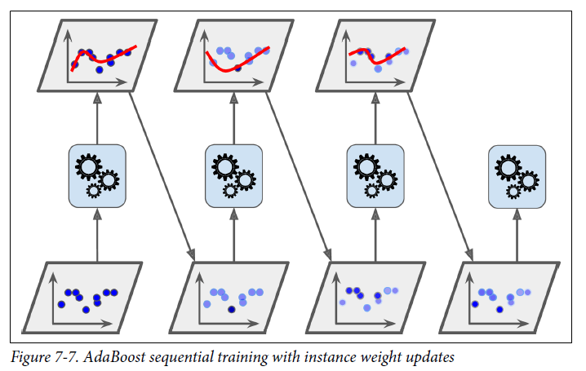
Weight updating – darkness is weight size

Slide 8
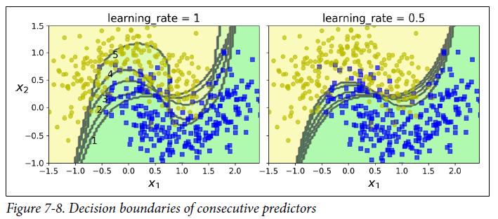
Learning rate (hyperparameter) $η$

Slide 9
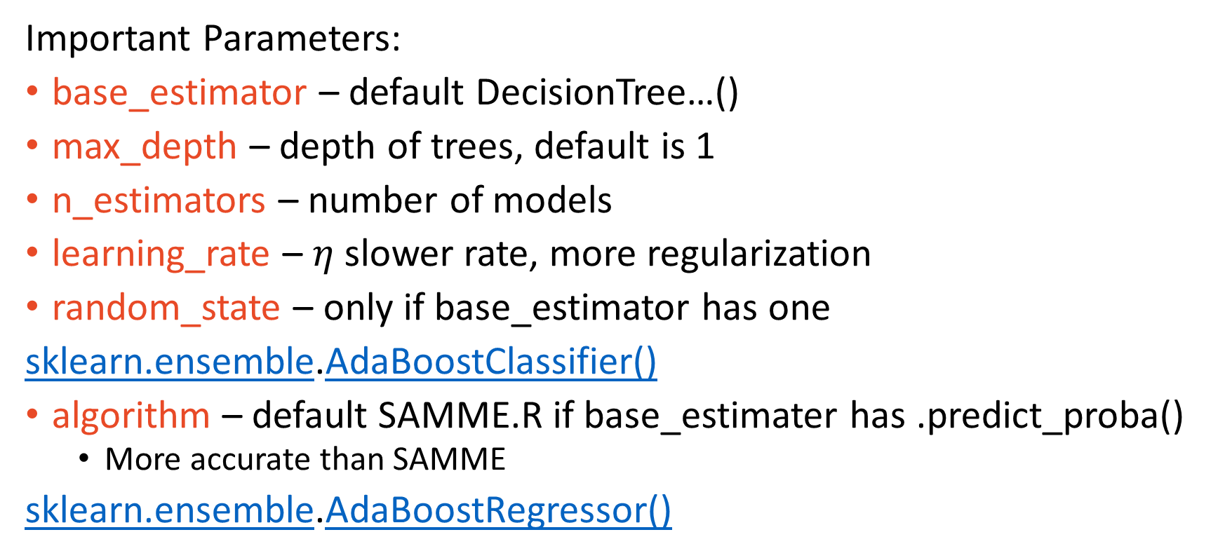
Implementation – Scikit-learn
Important Parameters:
base_estimator – default DecisionTree…()
max_depth – depth of trees, default is 1
n_estimators – number of models
learning_rate – $η$ slower rate, more regularization
random_state – only if base_estimator has one
sklearn.ensemble.AdaBoostClassifier()
algorithm – default SAMME.R if base_estimater has .predict_proba()
More accurate than SAMME
sklearn.ensemble.AdaBoostRegressor()

Slide 10
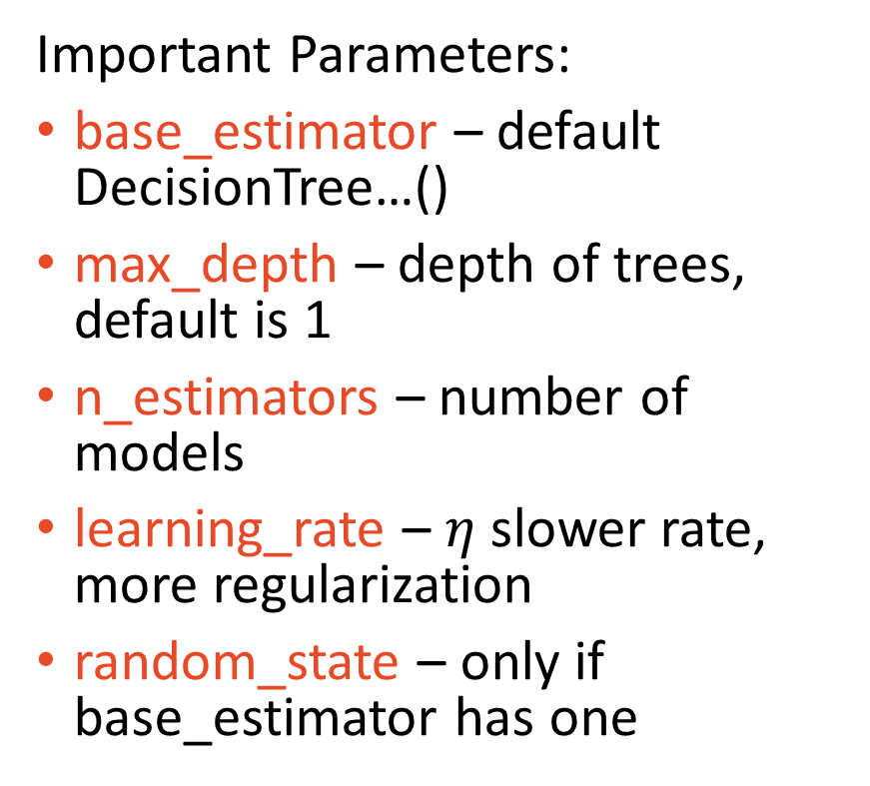
Implementation – Scikit-learn
Important Parameters:
base_estimator – default DecisionTree…()
max_depth – depth of trees, default is 1
n_estimators – number of models
learning_rate – $η$ slower rate, more regularization
random_state – only if base_estimator has one
sklearn.ensemble.AdaBoostClassifier()
algorithm
SAMME – hard voting
SAMME.R – soft voting
if base_estimater has .predict_proba()
more accurate than SAMME
sklearn.ensemble.AdaBoostRegressor()

Slide 11
Gradient Boost
Fitting residuals

Slide 12
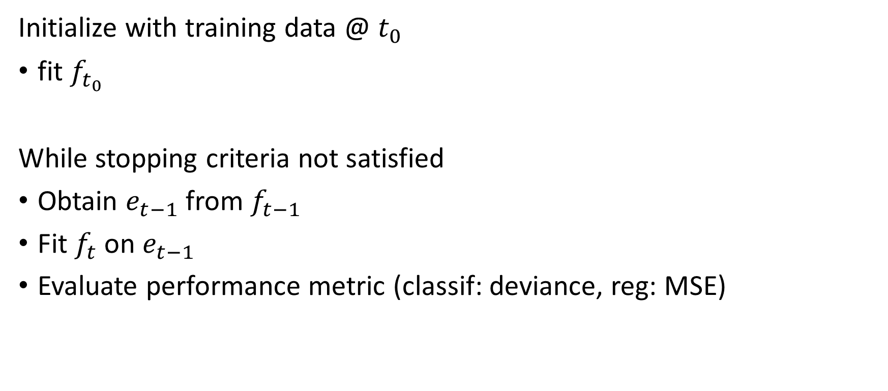
Gradient Boosting – Pseudo Code
Initialize with training data @ $t_{0}$
fit $f_{t_{0}}$
While stopping criteria not satisfied
Obtain $e_{t−1}$ from $f_{t−1}$
Fit $f_{t}$ on $e_{t−1}$
Evaluate performance metric (classif: deviance, reg: MSE)

Slide 13
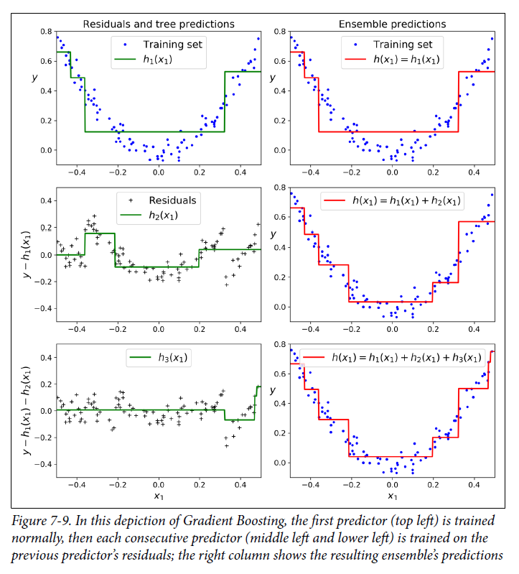
Three Steps of Gradient Boosting Visually

Slide 14
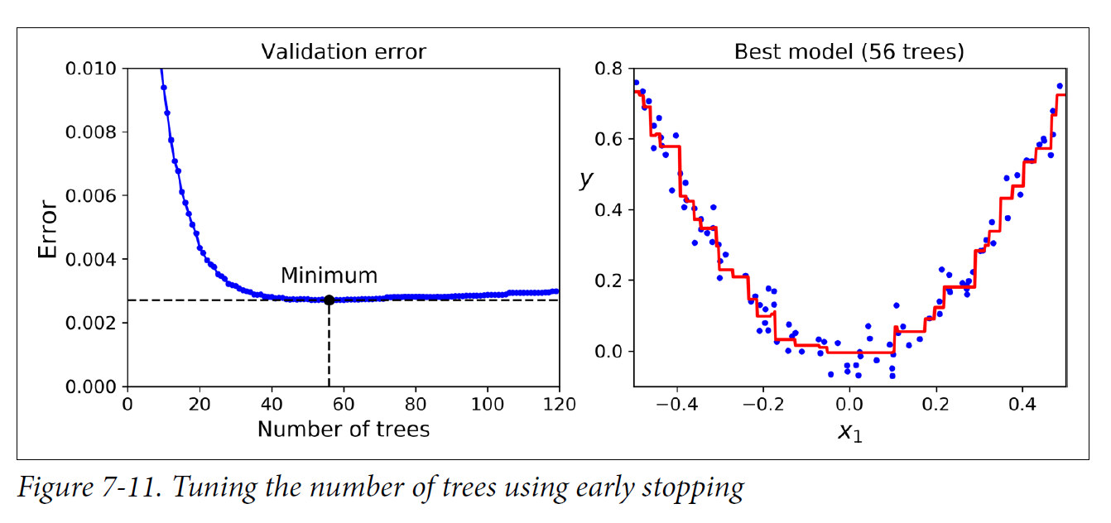
Early Stopping – No Prediction Improvement

Slide 15
Two Methods of Gradient Boosting
Regular - Minimize first derivative of performance metrics (MSE, deviance)
EXTREME!!!! – Minimize second derivative of performance metrics
Much faster
Tends to be more accruate

Slide 16
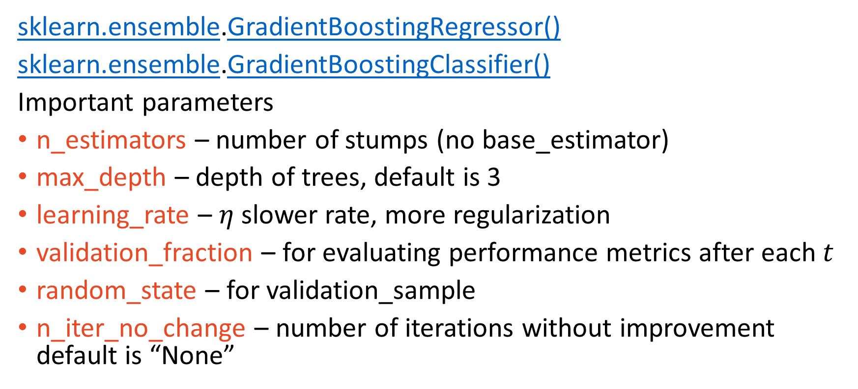
1) Implementation - Gradient Boosting Scikit-learn
sklearn.ensemble.GradientBoostingRegressor()
sklearn.ensemble.GradientBoostingClassifier()
Important parameters
n_estimators – number of stumps (no base_estimator)
max_depth – depth of trees, default is 3
learning_rate – $η$ slower rate, more regularization
validation_fraction – for evaluating performance metrics after each $t$
random_state – for validation_sample
n_iter_no_change – number of iterations without improvement default is “None”

Slide 17
2) Implementation - XGBoost
Similar to Scikit-learn
xgboost.XGBClassifier()
xgboost.XGBRegressor()
Important parameters
n_estimators, max_depth, learning_rate, random_state
Method .fit() important parameters
eval_set = [(x_valid, y_valid)] – separate from x_train, y_train
early_stopping_rounds – like n_iter_no_change, default is “None”

Slide 18
Main Takeaways
Boosting is fitting models sequentially conditional on previous models
Boosting is prone to overfitting
AdaBoost is about weighting observations
Gradient Boosting is about fitting residuals

